Slide 1
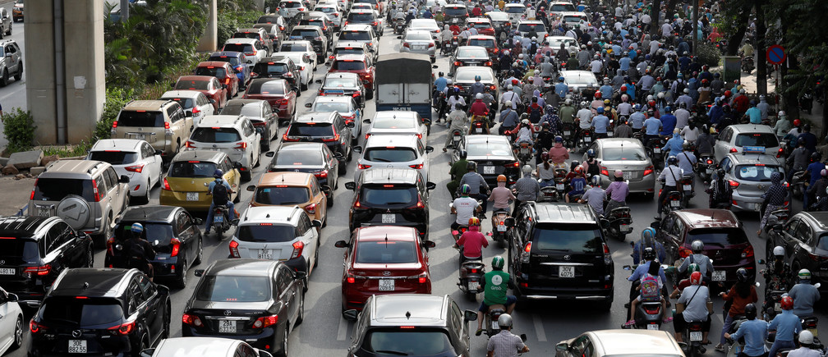
1. To formally tell somebody about something
INFORM (v) /ɪnˈfɔːrm/ sb about/of sth
2. An official rule made by the authority
REGULATION (n) /ˌreɡjuˈleɪʃn/
3. The act of suggesting a plan/idea OR asking sb for marriage
PROPOSAL (n) /prəˈpəʊzl/
4. To sum it up
SUMMARIZE (v) /ˈsʌməraɪz/
5. (picture)
CONGESTION (n) /kənˈdʒestʃən/
e.g: Necessary steps need to be taken to
reduce traffic congestion in Hanoi.
Manila is a heavily congested city.

Slide 2
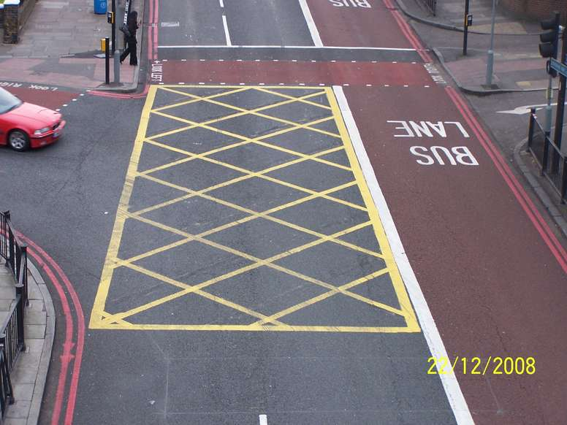

6. how far or well you can see, affected by the weather
VISIBILITY (n) /ˌvɪzəˈbɪləti/
e.g: When there is thick fog, visibility decreases to under 100 meters. (NOT reduce)
7. To collect someone waiting for you
PICK SB UP (phrasal verb)
8. When you are dissatisfied with sth, you make a …
COMPLAINT (n) /kəmˈpleɪnt/
9. To leave sb somewhere
DROP SB OFF (phrasal verb)
e.g: my dad dropped me off at the
British Council to take the IELTS test
10. (picture - yellow area)
11. (picture)
JUNCTION – BEND (n)

Slide 3
12. To do/follow what you are told or expected to
OBEY (v) /əˈbeɪ/ sb/sth (rules/orders/the law)
e.g: Vietnamese children are taught to obey their seniors
13. If you … the traffic, you reduce its volume.
REGULATE (v) /ˌreɡjuˈleɪt/
14. People who travel on foot
PEDESTRIAN (n) /pəˈdestriən/ (crossing)
e.g: My best place to in Hanoi at weekends is the old quarter,
more specifically the pedestrian precinct /ˈpriːsɪŋkt/
15. Perfect / flawless (adj)
IDEAL (v) /aɪˈdiːəl/

